Slide 1


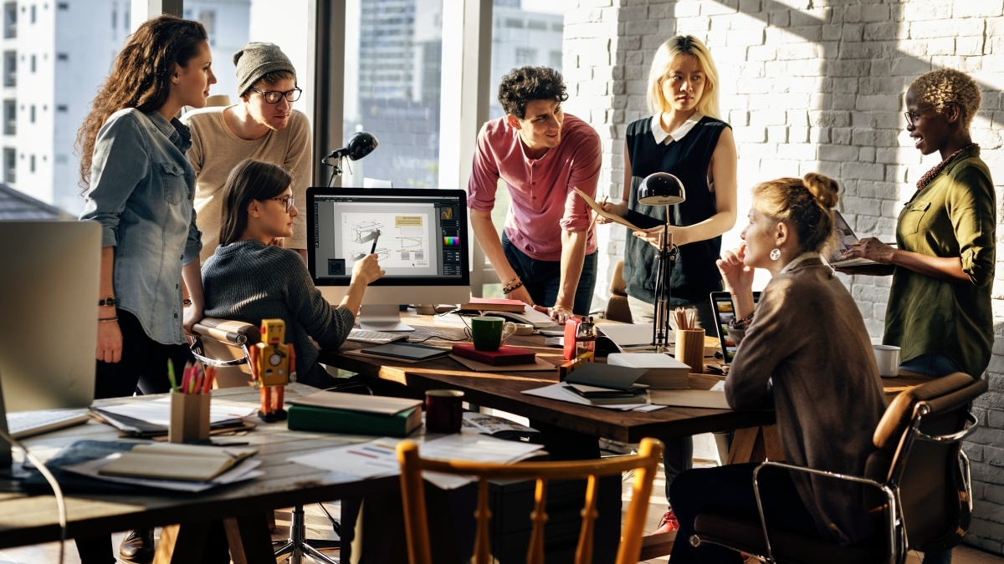
Laptop died right before a meet?

Slide 2
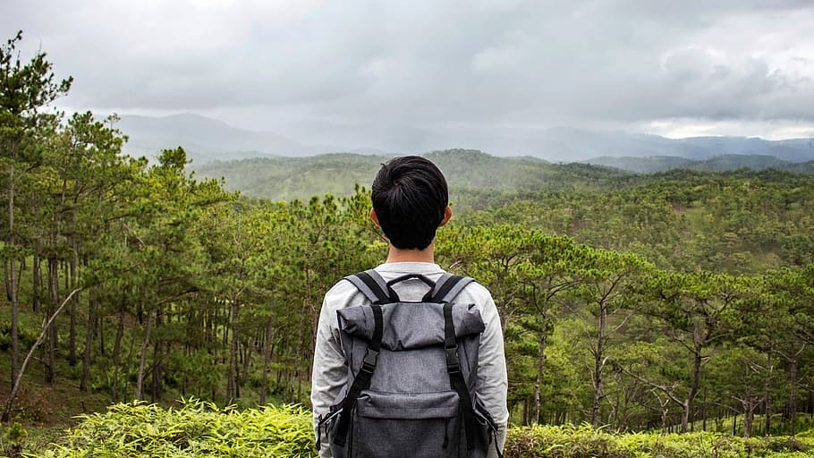
Can’t Call Someone Because Phone is Dead?

Slide 3
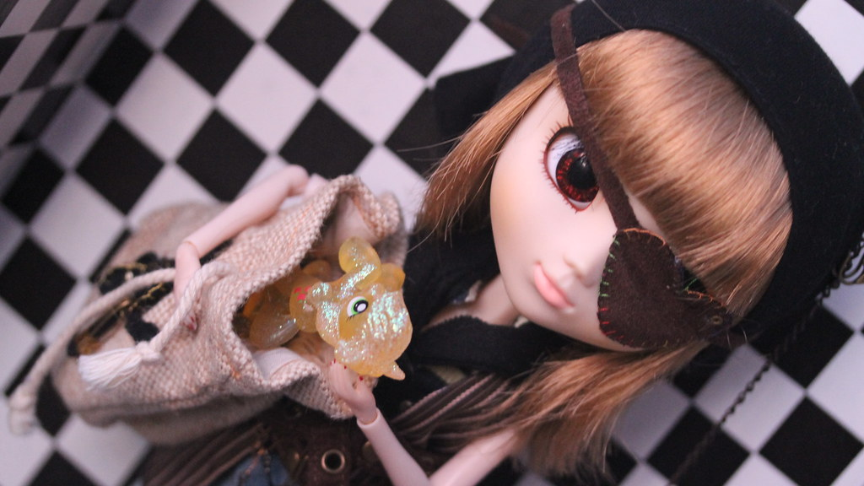
Wish your stuff was more secure in your bag?

Slide 4
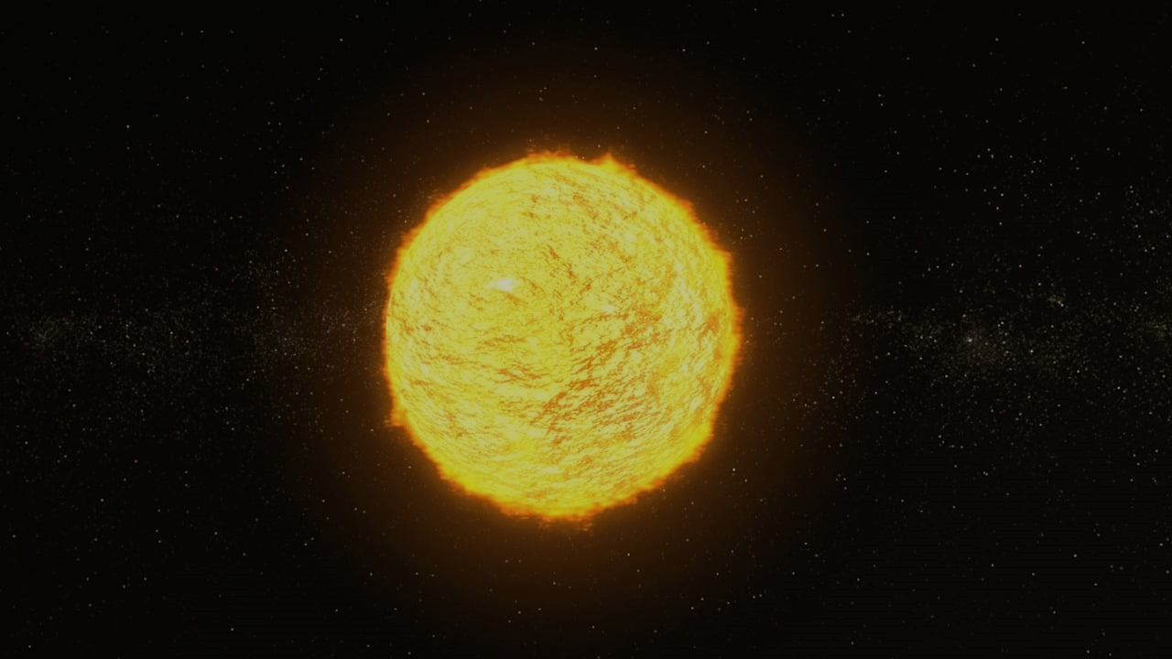
HELIOS
INTRODUCING

Slide 5

Why Choose Helios?

Slide 6
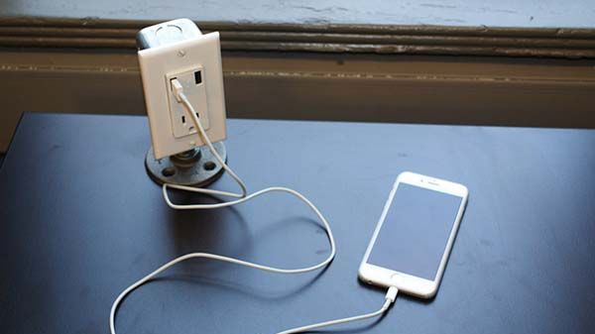
It charges your devices on the go

Slide 7
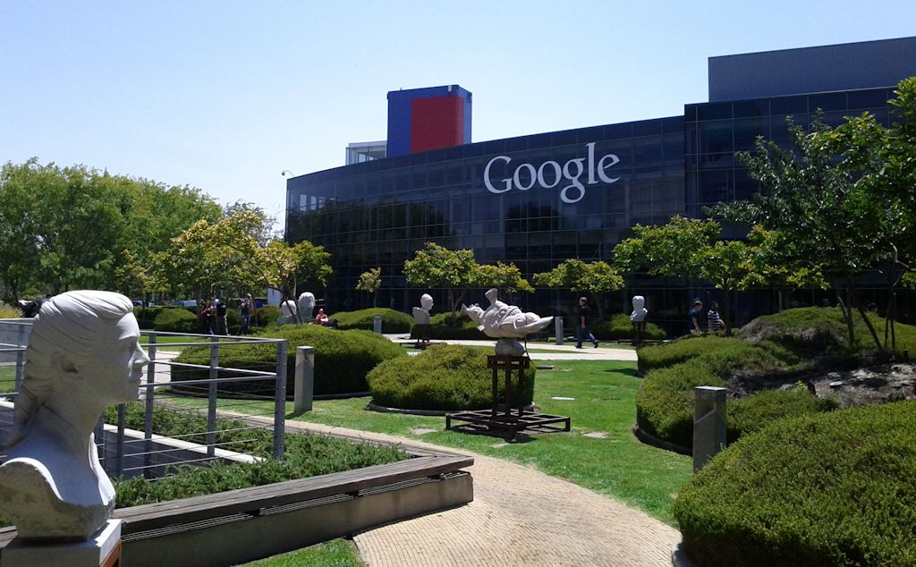
Experience the power of Google in your backpack

Slide 8

It is solar powered, so it’s also good for nature

Slide 9
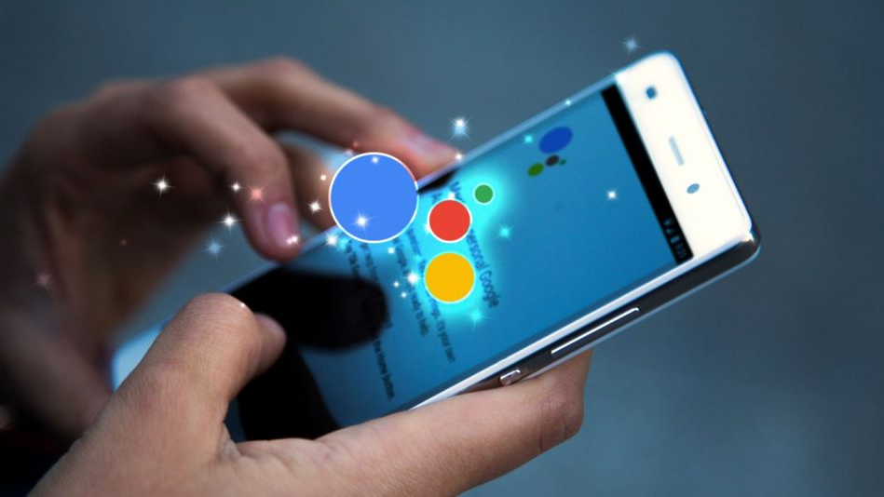
Uses voice recognition to protect your stuff

Slide 10

Durable, and made of the best quality material

Slide 11

fulfills your childhood dream of having a high-tech bag

Slide 12
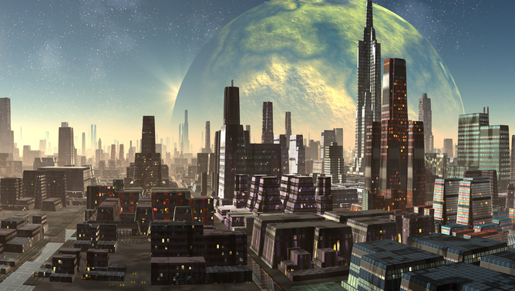
The future is closer than ever

Slide 13
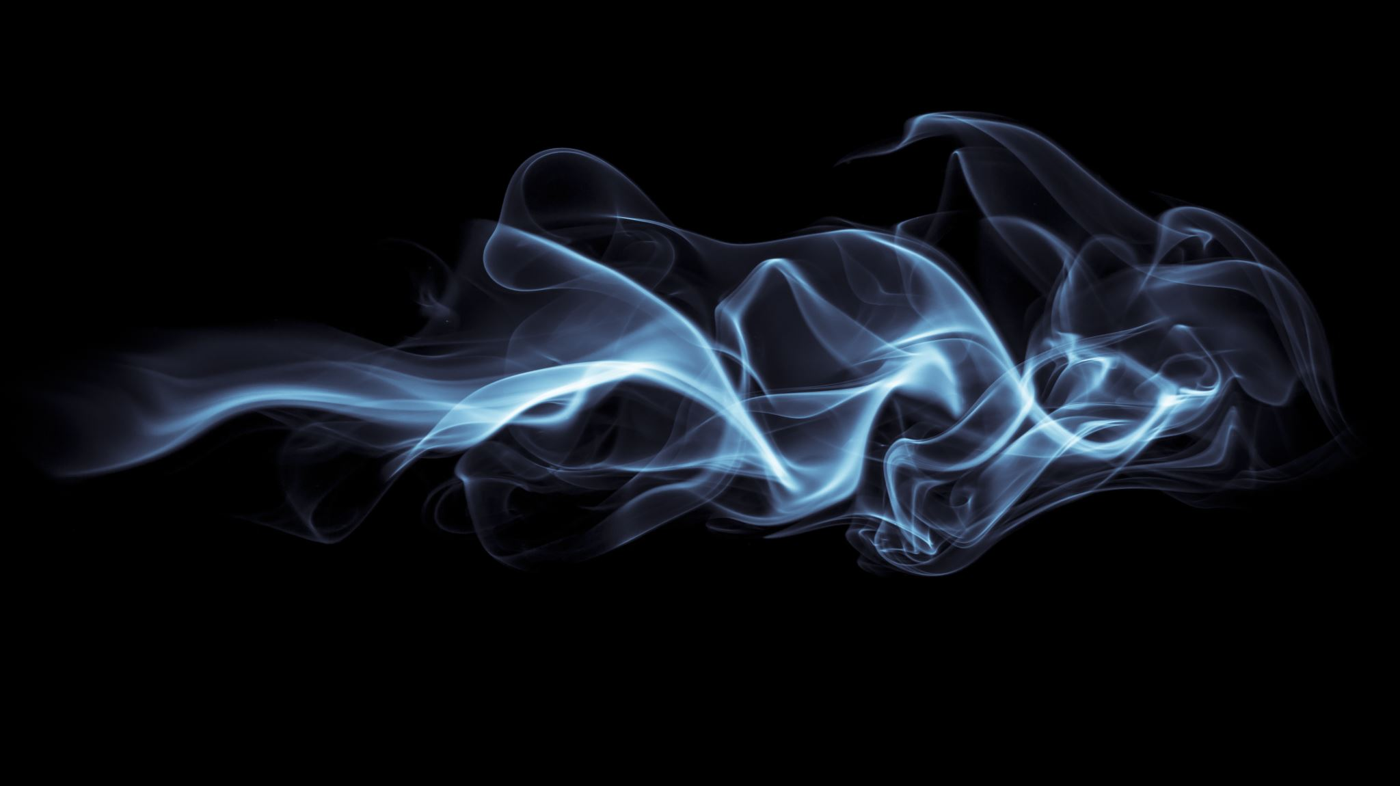
Helios
Innovation with the right amount of fashion

